Slide 1

Surds
Grade 6
Rationalising the Denominatior

Slide 2
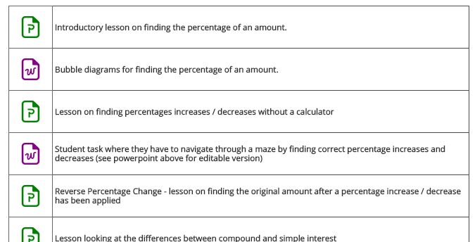
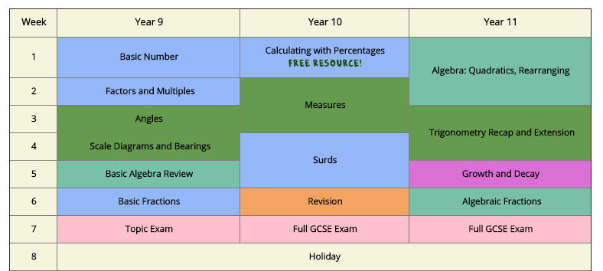
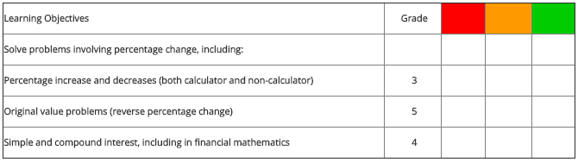
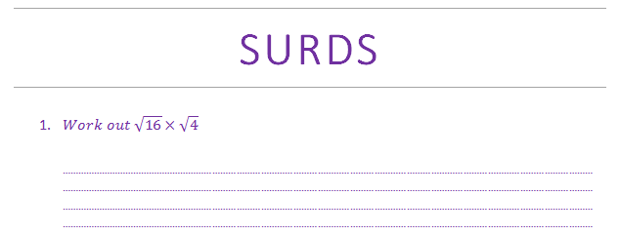
Schemes of work updated with the new content introduced into the GCSE specification
Teaching resources designed for the rigours of the new GCSE Specification
Topic assessments to monitor the progress of your students through the course

Slide 3
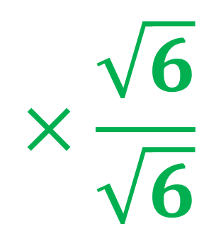
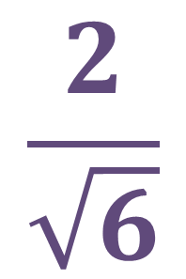
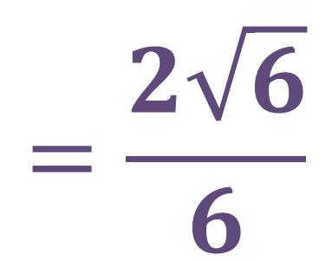
Rationalising the denominator
To rationalise the denominator, we multiply by a special type of 1
$$×\frac{\sqrt{6}}{\sqrt{6}}$$
$$=\frac{2\sqrt{6}}{6}$$
$$\frac{2}{\sqrt{6}}$$
Special type of 1

Slide 4
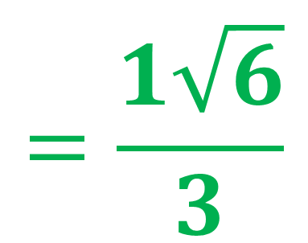

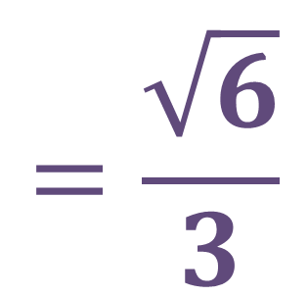
Simplifying our answer…
$$\frac{2\sqrt{6}}{6}$$
$$=\frac{1\sqrt{6}}{3}$$
$$=\frac{\sqrt{6}}{3}$$
Make sure you simplify your answer (if possible) every time

Slide 5
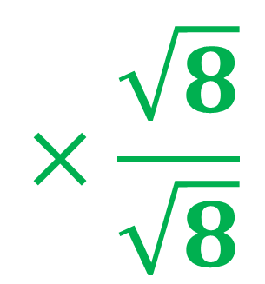
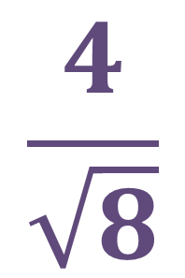
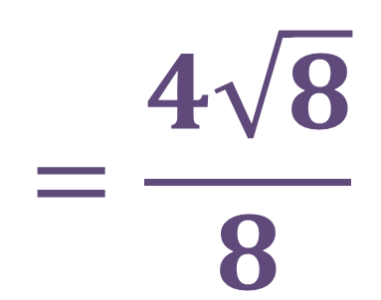
Rationalising the denominator
Again, to rationalise the denominator, we multiply by a special type of 1
$$×\frac{\sqrt{8}}{\sqrt{8}}$$
$$=\frac{4\sqrt{8}}{8}$$
$$\frac{4}{\sqrt{8}}$$
Special type of 1

Slide 6
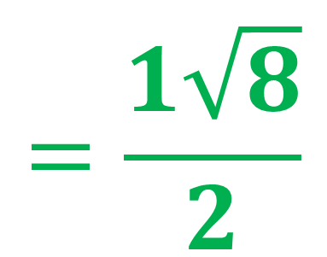

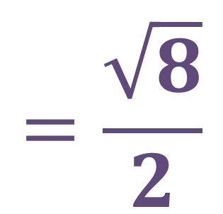
Simplifying our answer…
$$\frac{4\sqrt{6}}{8}$$
$$=\frac{1\sqrt{8}}{2}$$
$$=\frac{\sqrt{8}}{2}$$
Make sure you simplify your answer (if possible) every time

Slide 7
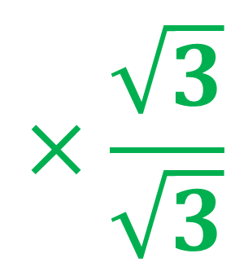
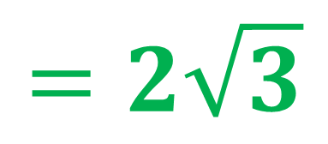
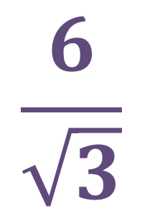

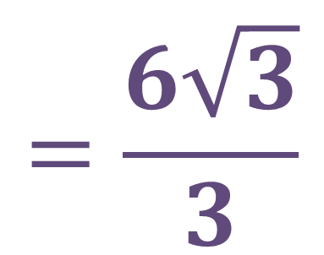
Rationalising the denominator
$$×\frac{\sqrt{3}}{\sqrt{3}}$$
$$=\frac{6\sqrt{3}}{3}$$
$$\frac{6}{\sqrt{3}}$$
$$\frac{6\sqrt{3}}{3}$$
$$=2\sqrt{3}$$

Slide 8
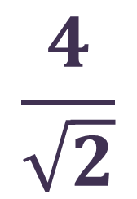
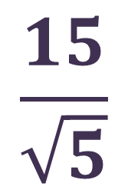
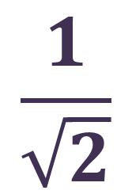
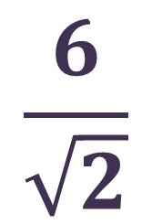
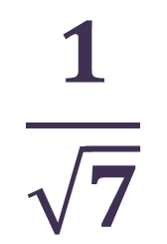
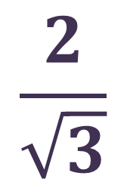
Quick Task - Rationalising the denominator
$$\frac{2}{\sqrt{3}}$$
$$\frac{1}{\sqrt{7}}$$
$$\frac{1}{\sqrt{2}}$$
Rationalising the denominator
$$\frac{6}{\sqrt{2}}$$
$$\frac{4}{\sqrt{2}}$$
$$\frac{15}{\sqrt{5}}$$

Slide 9
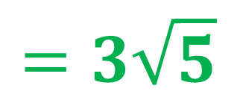
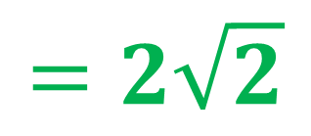
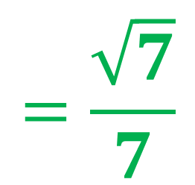
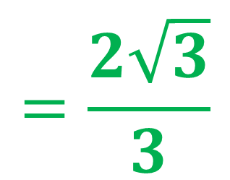
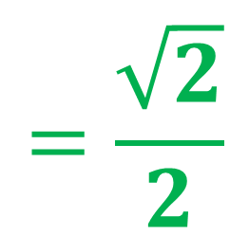
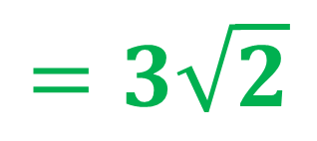
Rationalising the denominator Solutions
$$=\frac{2\sqrt{3}}{3}$$
$$\frac{2}{\sqrt{3}}$$
$$=\frac{\sqrt{7}}{7}$$
$$\frac{1}{\sqrt{7}}$$
$$\frac{1}{\sqrt{2}}$$
$$=\frac{\sqrt{2}}{2}$$
Rationalising the denominator
$$\frac{6}{\sqrt{2}}$$
$$=3\sqrt{2}$$
$$\frac{4}{\sqrt{2}}$$
$$=2\sqrt{2}$$
$$\frac{15}{\sqrt{5}}$$
$$=3\sqrt{5}$$

Slide 10
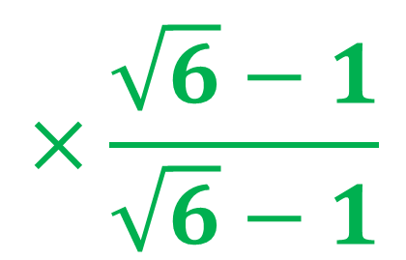
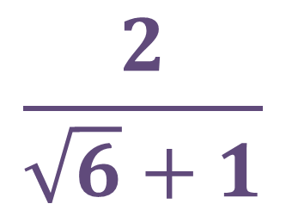
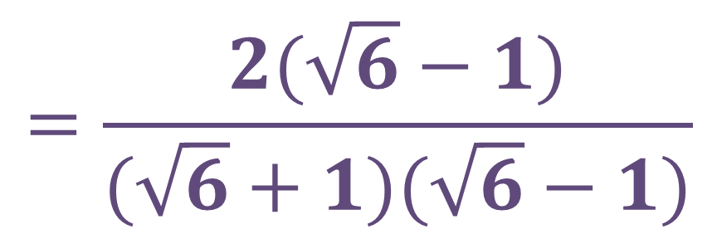
Rationalising the denominator
What’s different here?
Nothing changes, all we do is change our special type of 1
$$×\frac{\sqrt{6}−1}{\sqrt{6}−1}$$
$$=\frac{2(\sqrt{6}−1)}{(\sqrt{6}+1)(\sqrt{6}−1)}$$
$$\frac{2}{\sqrt{6}+1}$$
Special type of 1

Slide 11


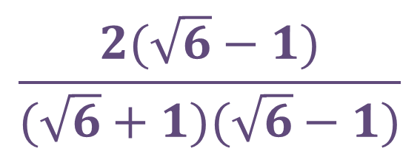


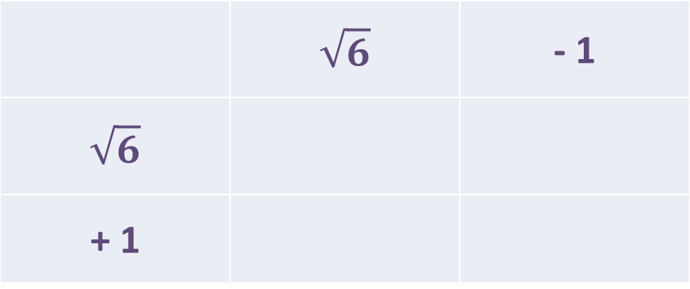
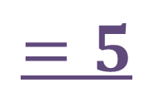
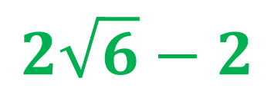
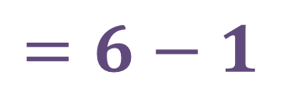
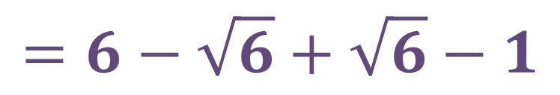
Rationalising the denominator
$$\frac{2(\sqrt{6}−1)}{(\sqrt{6}+1)(\sqrt{6}−1)}$$
$$2\sqrt{6}−2$$
$$=$$
$$5$$
$$=6−\sqrt{6}+\sqrt{6}−1$$
 | $$\sqrt{6}$$ | - 1
$$\sqrt{6}$$
+ 1
+6
$$−\sqrt{6}$$
Cancel each other out
$$+\sqrt{6}$$
-1
$$=6−1$$
$$=5$$

Slide 12
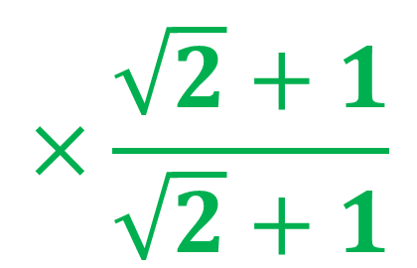
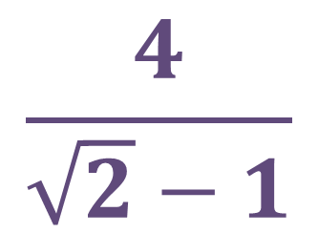
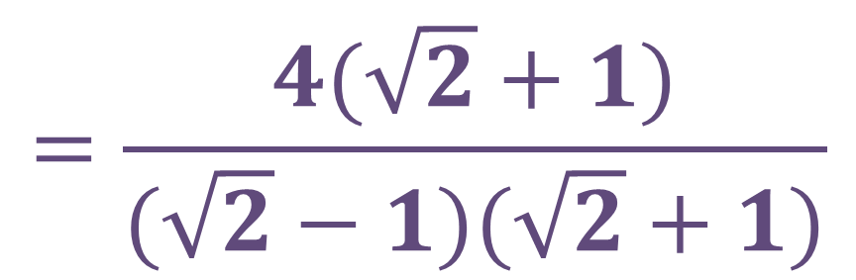
Rationalising the denominator
$$×\frac{\sqrt{2}+1}{\sqrt{2}+1}$$
$$=\frac{4(\sqrt{2}+1)}{(\sqrt{2}−1)(\sqrt{2}+1)}$$
$$\frac{4}{\sqrt{2}−1}$$
Special type of 1

Slide 13
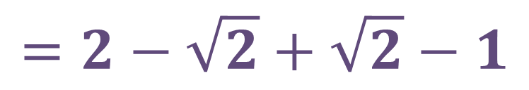
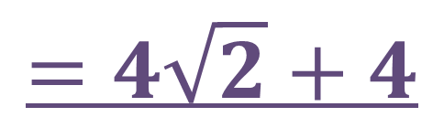




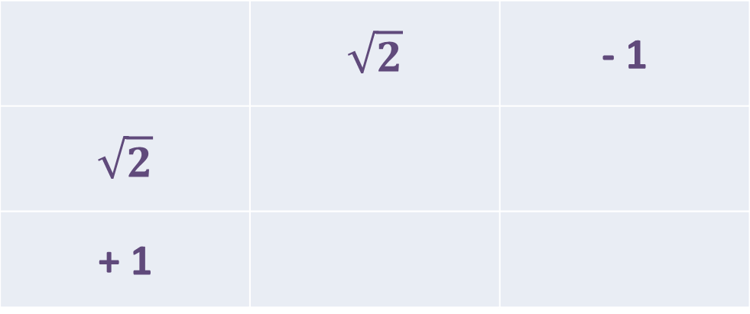



Rationalising the denominator
$$\frac{4(\sqrt{2}+1)}{(\sqrt{2}−1)(\sqrt{2}+1)}$$
4$\sqrt{2}+4$
$$=$$
$$=4\sqrt{2}+4$$
$$1$$
 | $$\sqrt{2}$$ | - 1
$$\sqrt{2}$$
+ 1
$$=2−\sqrt{2}+\sqrt{2}−1$$
+ 2
$$−\sqrt{2}$$
Cancel each other out
$$+\sqrt{2}$$
- 1
$$=1$$

Slide 14












Now you know the correct multipliers, can you rationalise the fractions?
Rationalising the denominator
What multiplier (special type of 1) would you use to rationalise the following fractions?
$$×\frac{\sqrt{2}−1}{\sqrt{2}−1}$$
$$×\frac{5−\sqrt{2}}{5−\sqrt{2}}$$
$$\frac{5}{\sqrt{2}+1}$$
$$\frac{6}{5+\sqrt{2}}$$
$$×\frac{\sqrt{3}+2}{\sqrt{3}+2}$$
$$×\frac{2−\sqrt{3}}{2−\sqrt{3}}$$
$$\frac{4}{\sqrt{3}−2}$$
$$\frac{3}{2+\sqrt{3}}$$
$$×\frac{\sqrt{3}−5}{\sqrt{3}−5}$$
$$×\frac{2+\sqrt{2}}{2+\sqrt{2}}$$
$$\frac{3}{\sqrt{3}+5}$$
$$\frac{1}{2−\sqrt{2}}$$

Slide 15














Rationalising the denominator
$$\frac{5}{\sqrt{2}+1}$$
$$×\frac{\sqrt{2}−1}{\sqrt{2}−1}$$
$$=\frac{5(\sqrt{2}−1)}{(\sqrt{2}+1)(\sqrt{2}−1)}$$
$$=\frac{5\sqrt{2}−5}{1}$$
$$=5\sqrt{2}−5$$
$$\frac{4}{\sqrt{3}−2}$$
$$×\frac{\sqrt{3}+2}{\sqrt{3}+2}$$
$$=\frac{4(\sqrt{3}+2)}{(\sqrt{3}−2)(\sqrt{3}+2)}$$
$$=\frac{4\sqrt{3}+8}{−1}$$
$$=−4\sqrt{3}−8$$
$$\frac{3}{\sqrt{3}+5}$$
$$×\frac{\sqrt{3}−5}{\sqrt{3}−5}$$
$$=\frac{3(\sqrt{3}−5)}{(\sqrt{3}+5)(\sqrt{3}−5)}$$
$$=\frac{3\sqrt{3}−15}{−23}$$

Slide 16














Rationalising the denominator
$$\frac{6}{5+\sqrt{2}}$$
$$×\frac{5−\sqrt{2}}{5−\sqrt{2}}$$
$$=\frac{6(5−\sqrt{2})}{(5+\sqrt{2})(5−\sqrt{2})}$$
$$=\frac{30−6\sqrt{2}}{23}$$
$$\frac{3}{2+\sqrt{3}}$$
$$×\frac{2−\sqrt{3}}{2−\sqrt{3}}$$
$$=\frac{3(2−\sqrt{3})}{(2+\sqrt{3})(2−\sqrt{3})}$$
$$=\frac{6−3\sqrt{3}}{1}$$
$$=6−3\sqrt{3}$$
$$×\frac{2+\sqrt{2}}{2+\sqrt{2}}$$
$$=\frac{1(2+\sqrt{2})}{(2−\sqrt{2})(2+\sqrt{2})}$$
$$=\frac{2+\sqrt{2}}{2}$$
$$=1+\frac{\sqrt{2}}{2}$$
$$\frac{1}{2−\sqrt{2}}$$

Slide 17











Surds – Stretch and Challenge (Pythagoras)
$${\left(5+\sqrt{7}\right)}^{2}+{\left(5−\sqrt{7}\right)}^{2}=x^{2}$$
$$(32+10\sqrt{7})$$
$$+ (18−10\sqrt{7})$$
$$=x^{2}$$
$$x$$
$$50=x^{2}$$
$$5+\sqrt{7}$$
$$\sqrt{50}=x$$
$$\sqrt{25}×\sqrt{2}=x$$
$$5\sqrt{2}=x$$
$$5−\sqrt{7}$$

